Slide 1
VesPA System on Chip
Embedded Systems

Slide 2
Agenda
1. Introduction
- Overview of VesPA System on Chip
- Objectives of the presentation
2. Custom Interconnect
- Overview of Updated Custom Interconnect
- Comparison of Custom Interconnect and AXI
- Trade-offs between Custom and AXI buses
3. Peripherals Update
- UART Peripheral
- PS2 Peripheral
- Timer Peripheral
- Interrupt Control
4. Pipeline Design and Analysis
- Overview of Pipeline Architecture
- Stages
- Pipeline Hazards Analysis
5. Hazard Unit Design and Analysis
- Analysis of Structural and Data Hazards
- Scoreboarding Technique
- Control Hazards and Prediction Methods

Slide 3
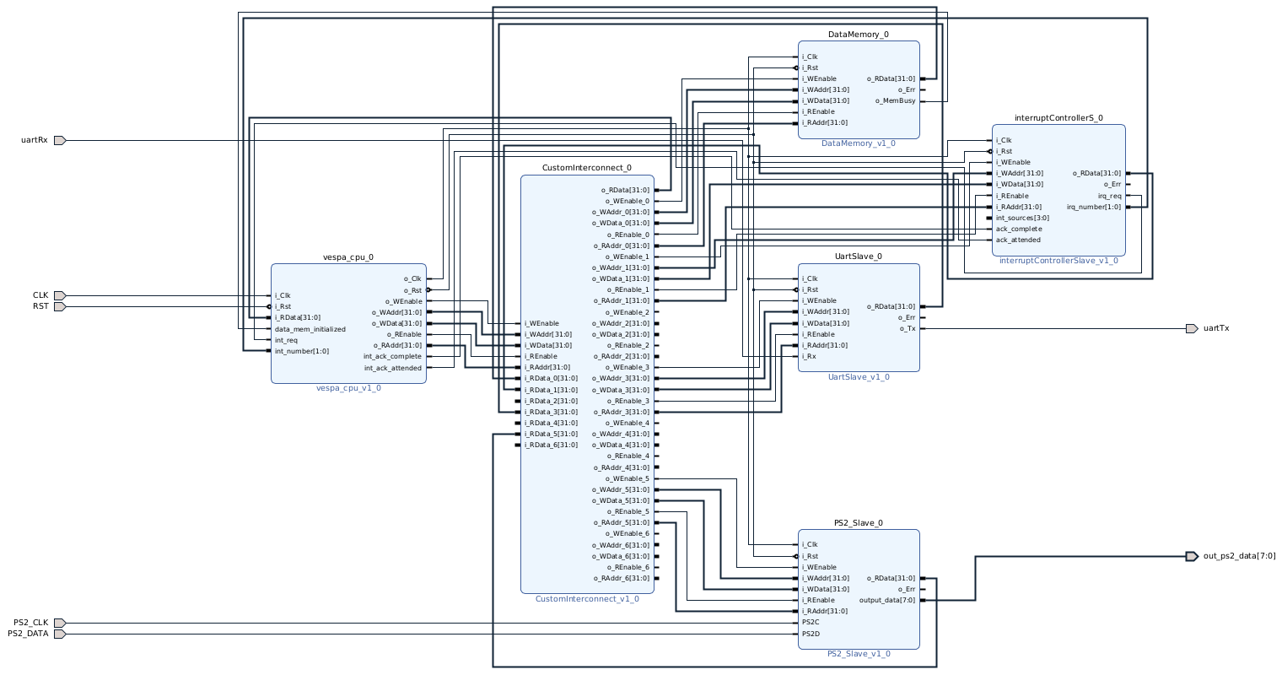
Block Design

Slide 4
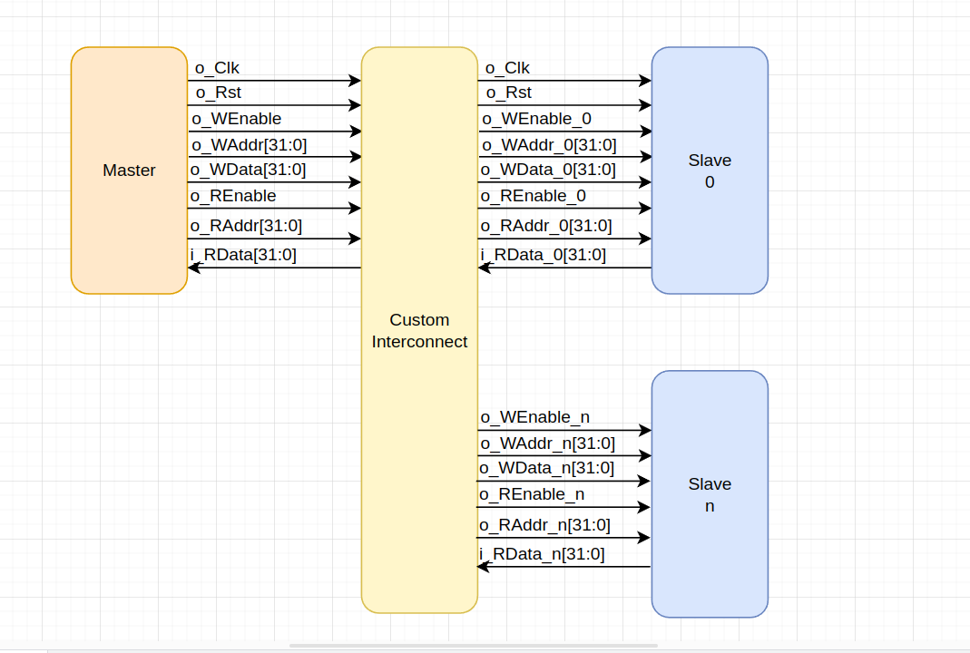
Custom Interconnect

Slide 5
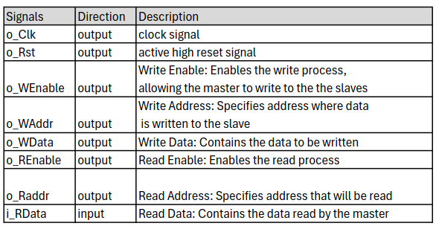
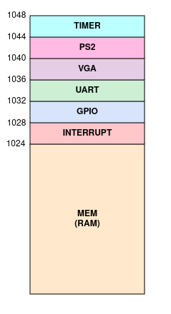
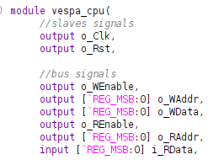
Custom Interconnect

Slide 6
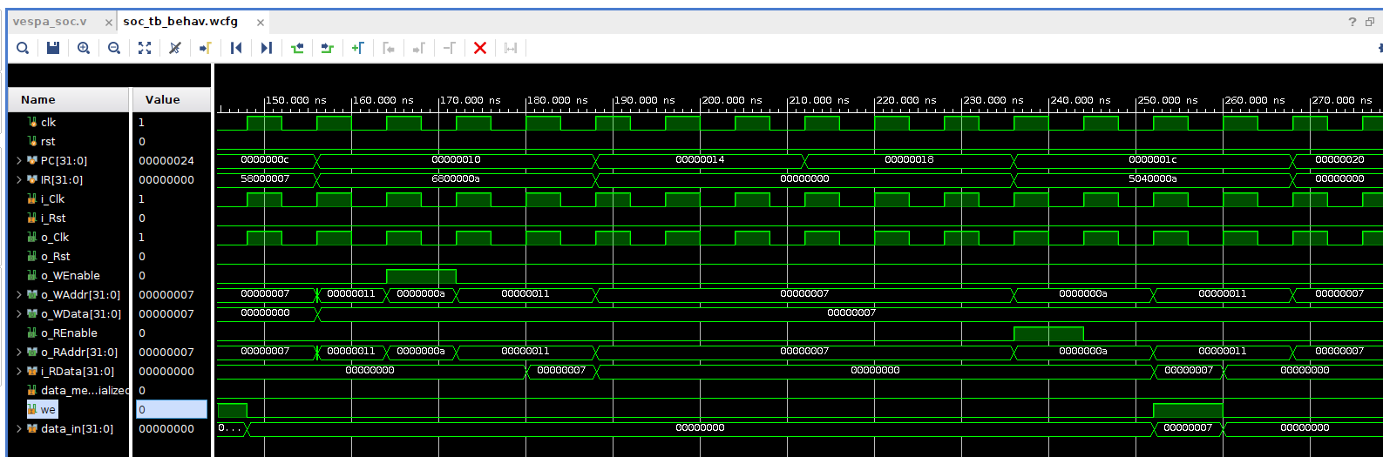
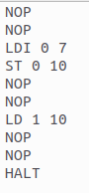
Custom Interconnect signals

Slide 7
Bus Trade-off
(Custom vs AXI)
Less delay
5 cycles delay for AXI vs 1 cycle delay for the custom bus
Less complexity
Uses fewer signals, which makes it simpler to use
Acknowledge signals
The AXI protocol uses acknowledge signals, while on the custom bus assumes the connection is always successful
Scalability
The AXI protocol supports the addition of new peripherals without the need to interfere with the AXI interconnect, which is not possible with the custom bus, when a new peripheral is added, it needs to be added to the interconnecter

Slide 8
Peripherals

Slide 9
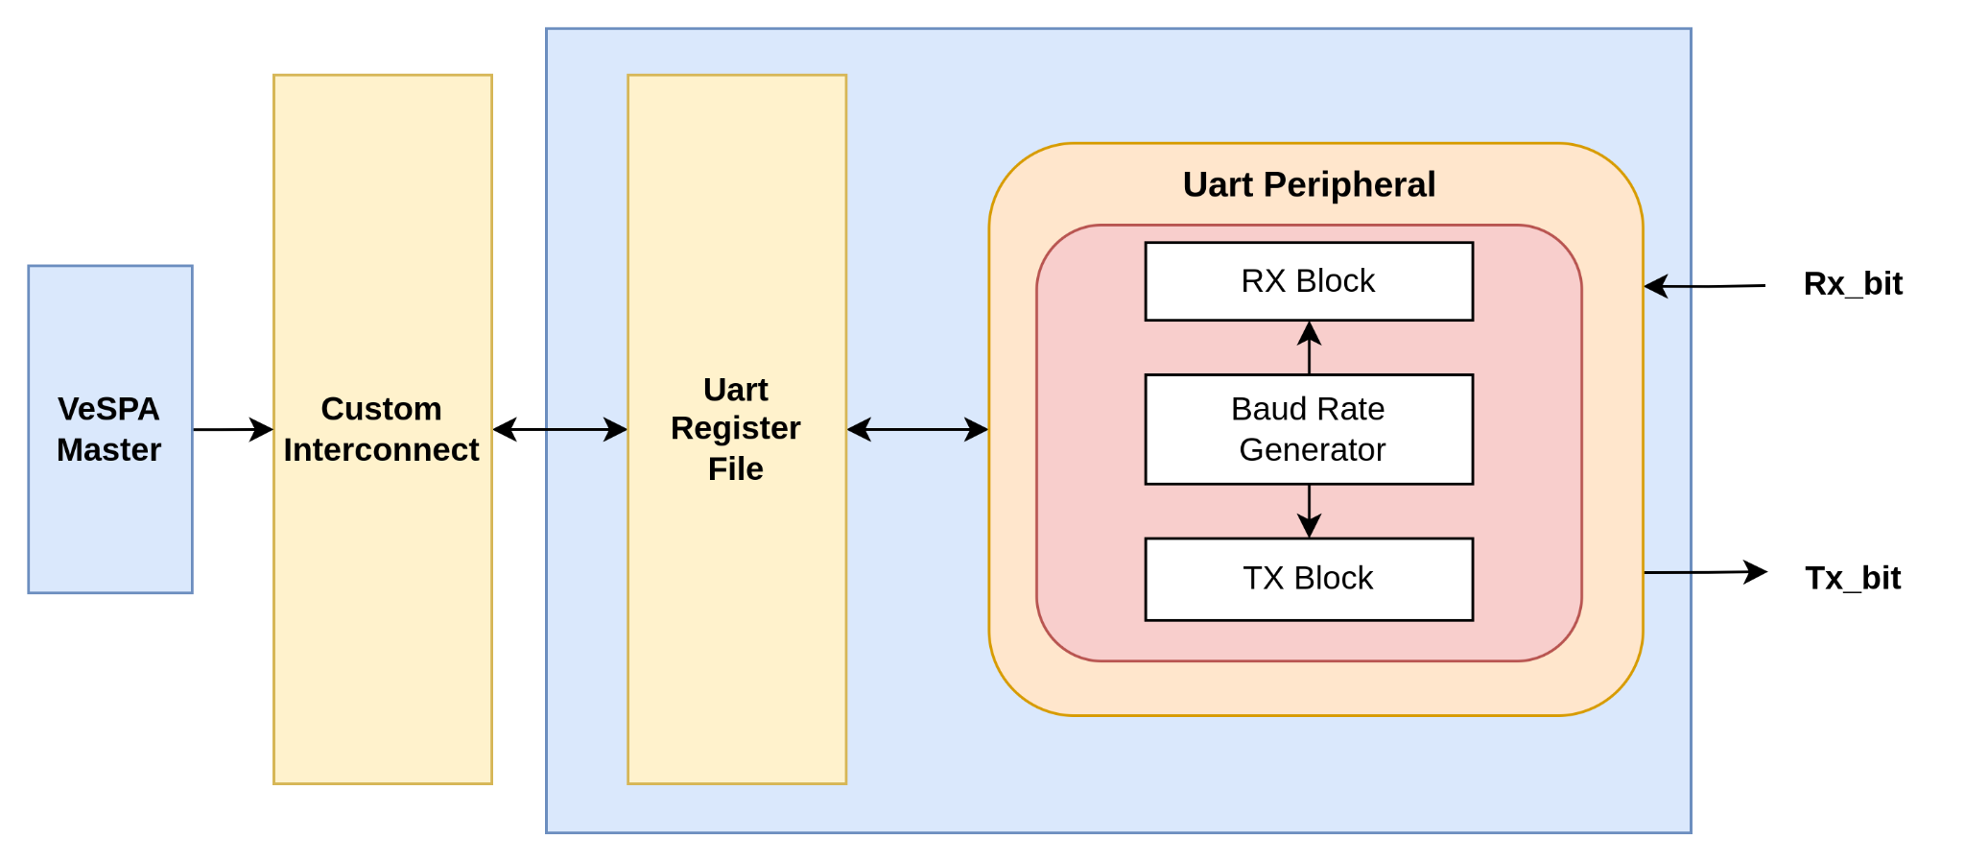
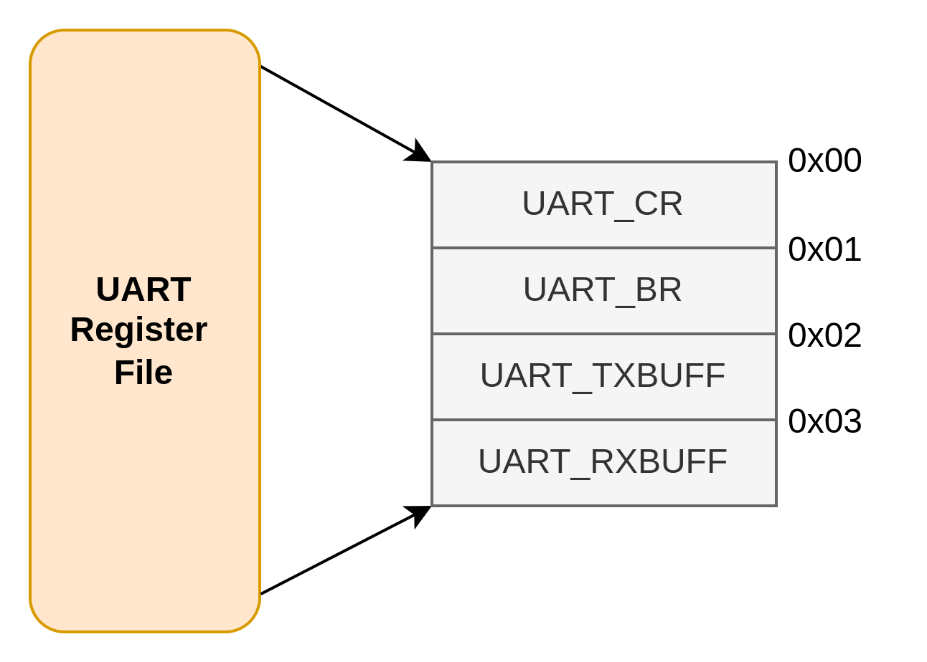
UART
Peripheral Overview

Slide 10
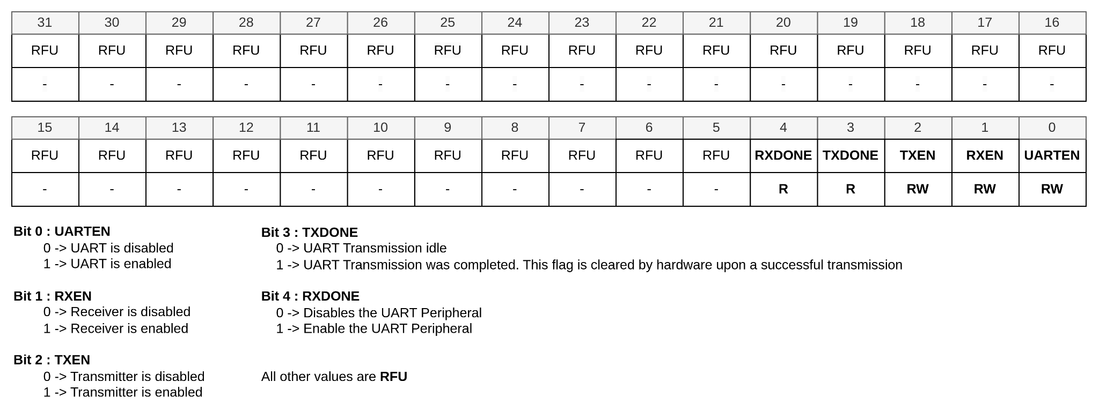
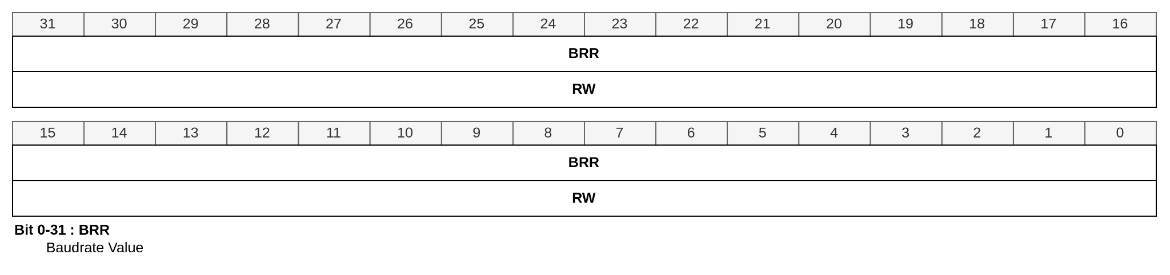
UART
UART_CR (Control Register) and UART_BRR (BaudRate Register)

Slide 11
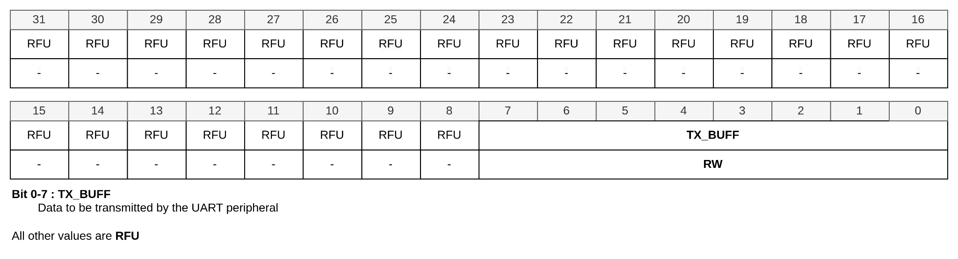
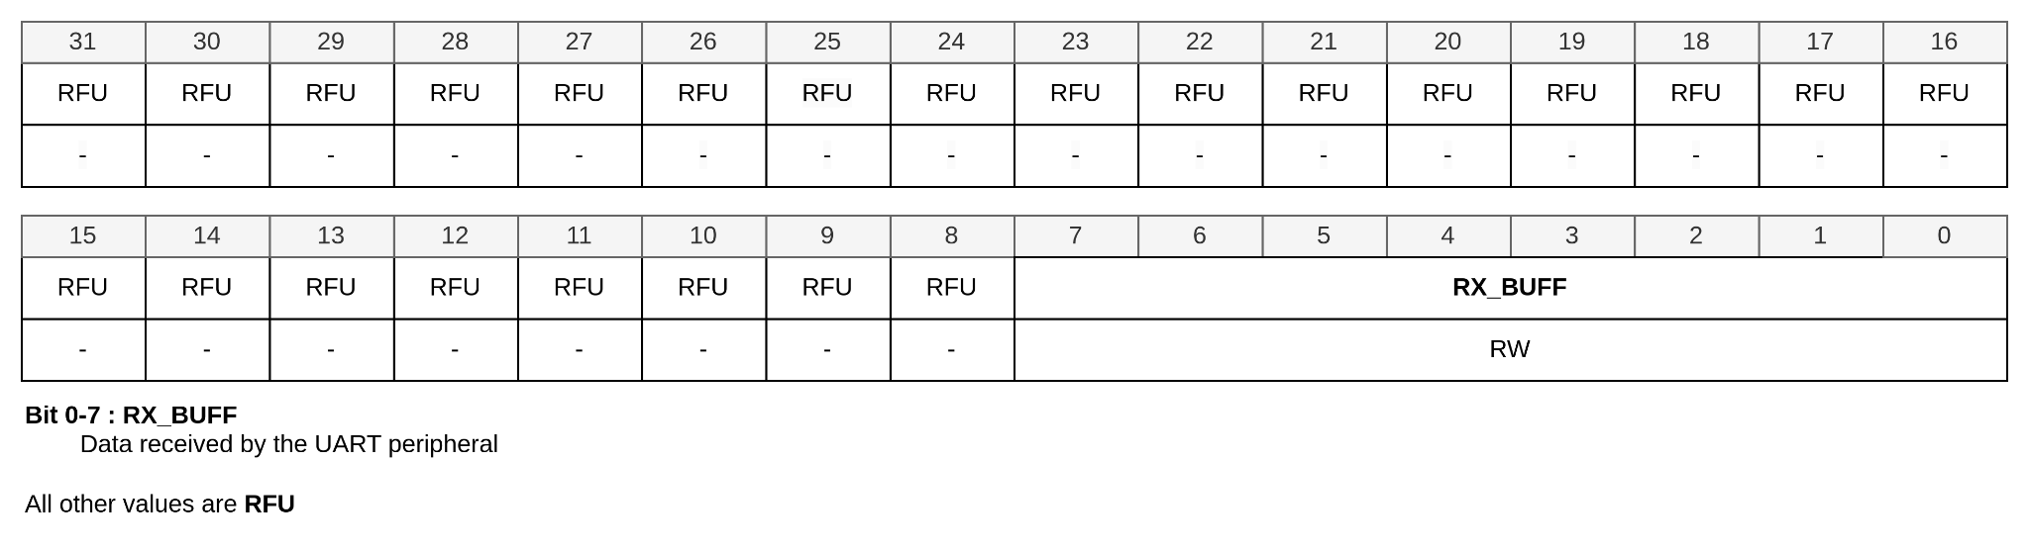
UART
UART_TxBUFF and RxBUFF Registers

Slide 12
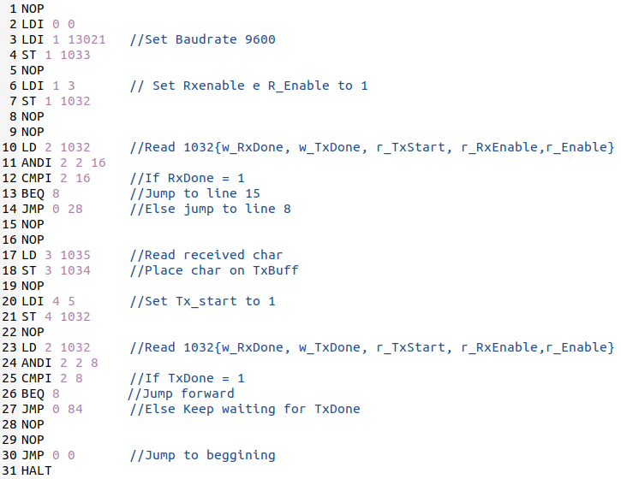
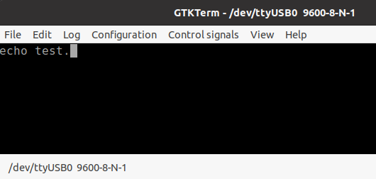
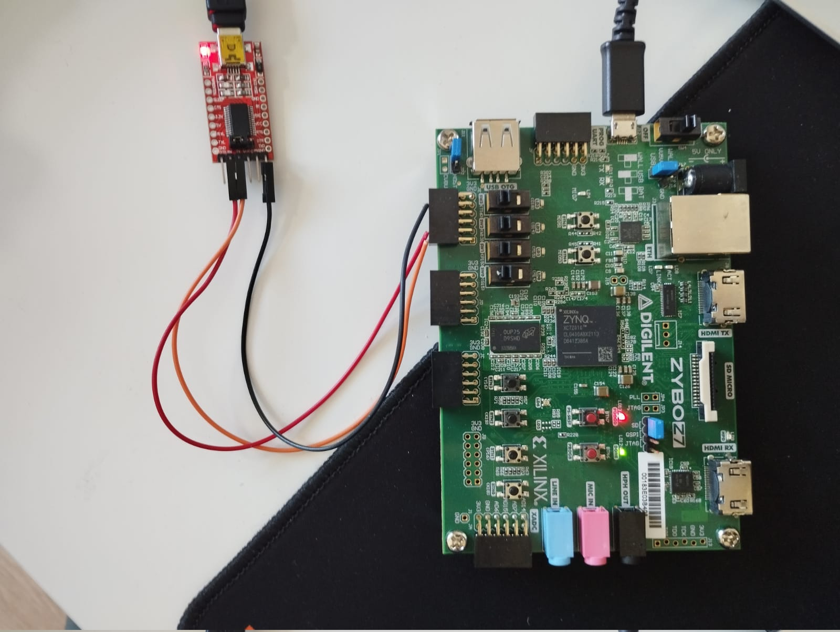
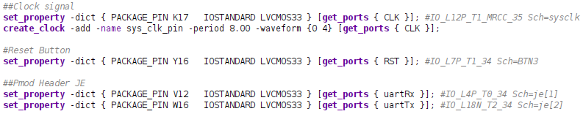
UART
Module Echo Test after Bitstream
Echo Test Output
Code in VeSPA for Echo
Constraints
Zybo + FTDI

Slide 13
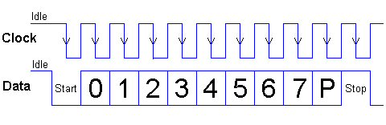
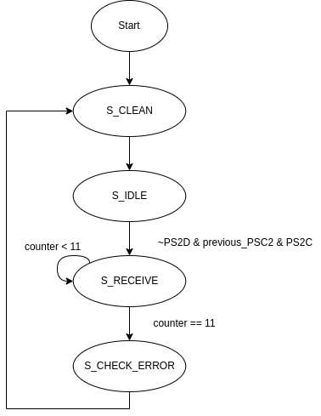
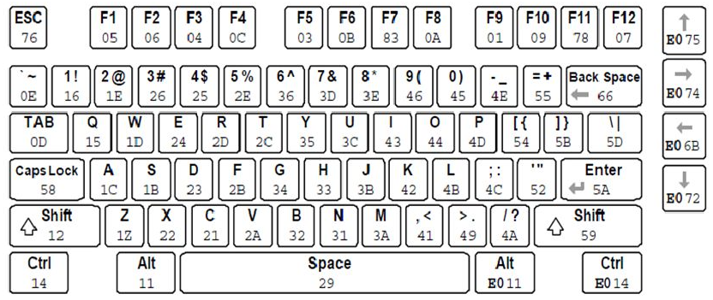
PS2
Ps2 Protocol
State Machine
PS2 Keys

Slide 14
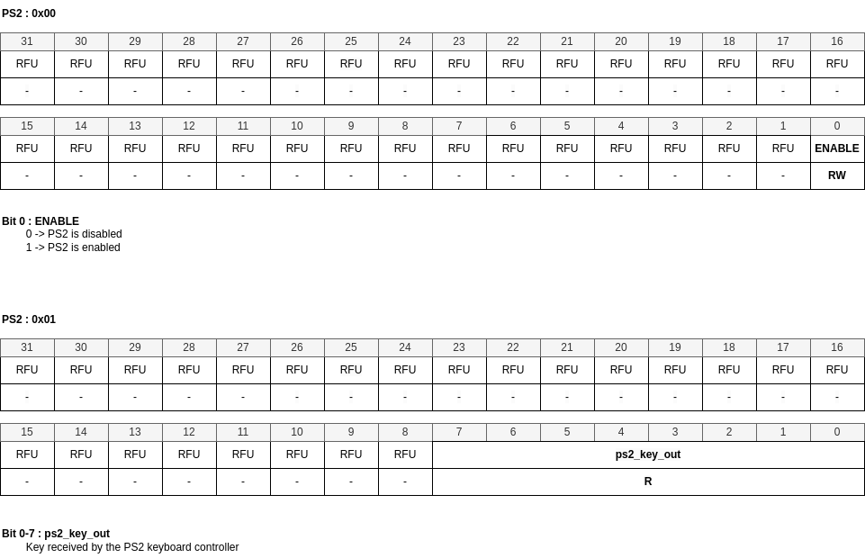
PS2
PS2 Registers

Slide 15
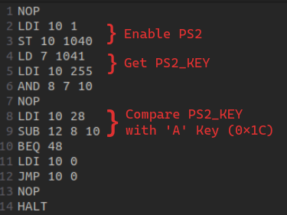
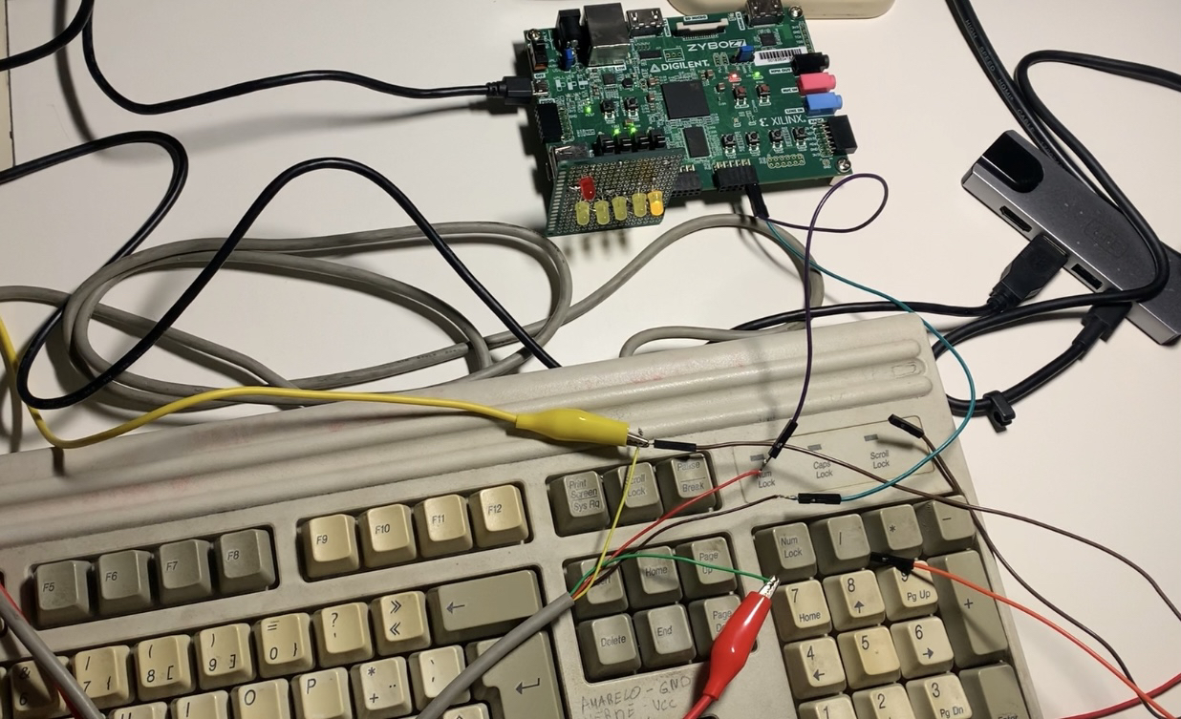
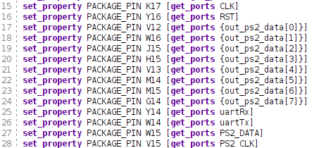
PS2
PS2 Test
Test Code in Assembly for PS2
Zybo + PS2 Keyboard
(PS2_KEY mapped in LEDs)
Constraints

Slide 16
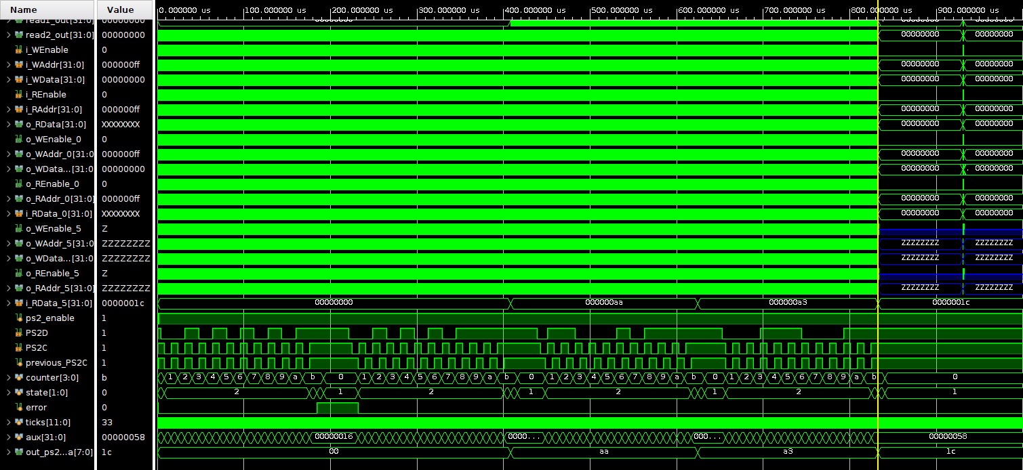
PS2 Testbench

Slide 17
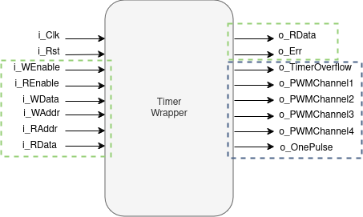
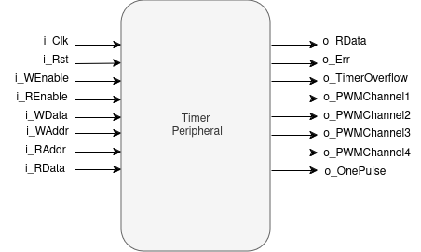
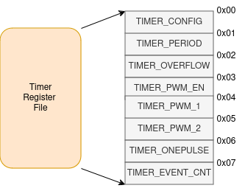
Timer
Interface with Interconnect
Timer peripheral Overview
Interconnect Registers

Slide 18
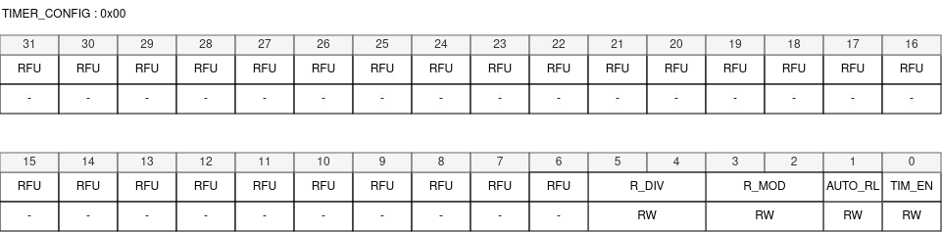
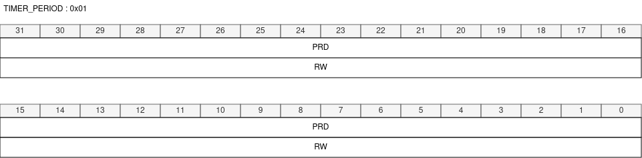
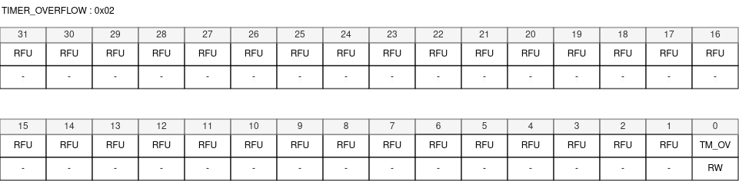
Timer

Slide 19
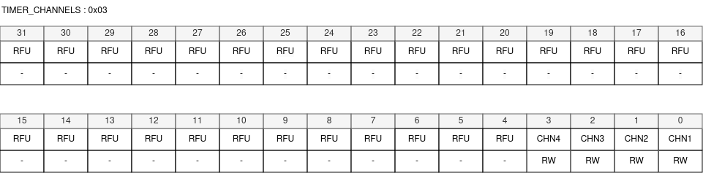
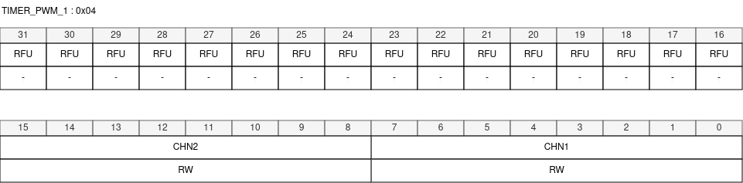
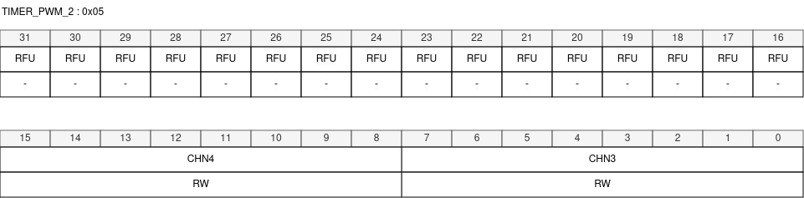
Timer

Slide 20
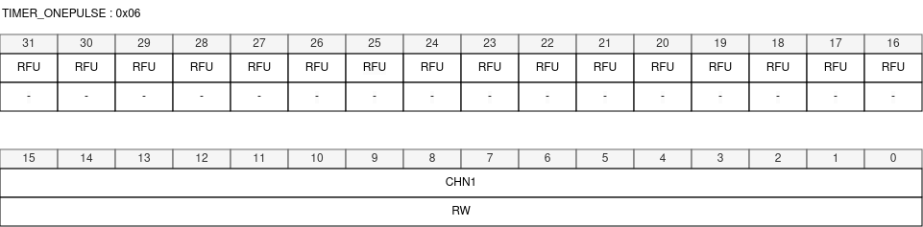
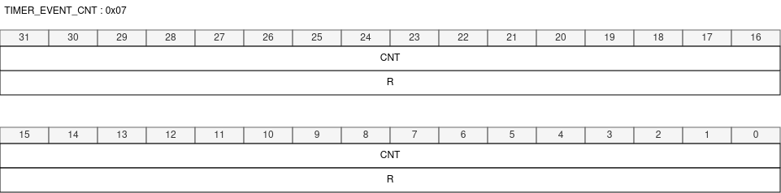
Timer

Slide 21
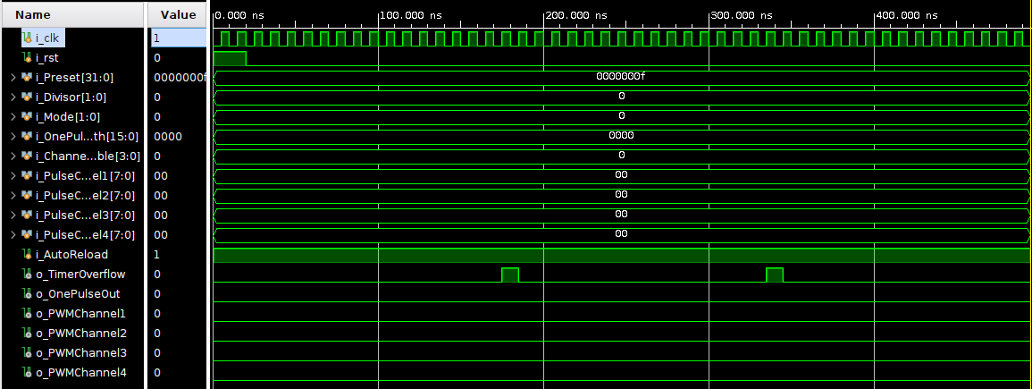
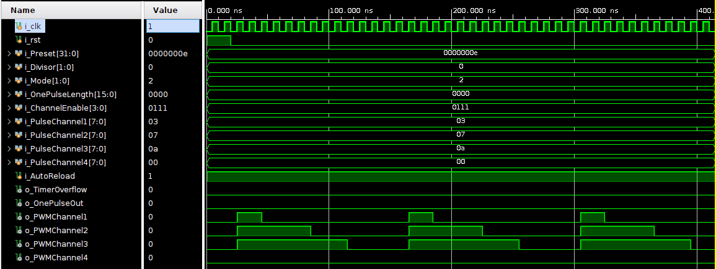
Timer
Timer mode with autorreload
PWM mode with Autorreload

Slide 22
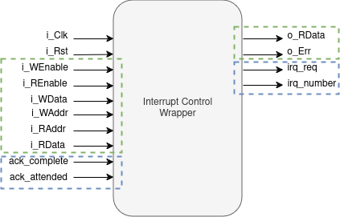
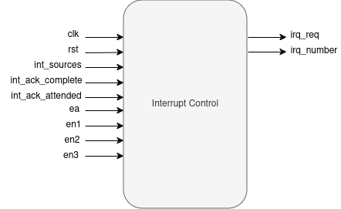
Interrupt Control
Interface with Interconnect
Interrupt Control Overview

Slide 23
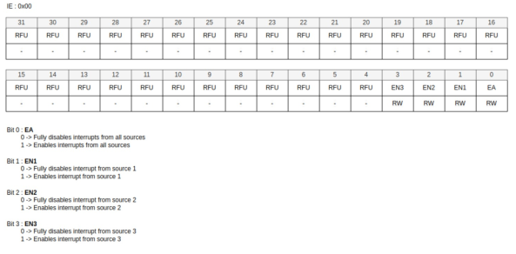
Interrupt Control
Write data and Read data

Slide 24
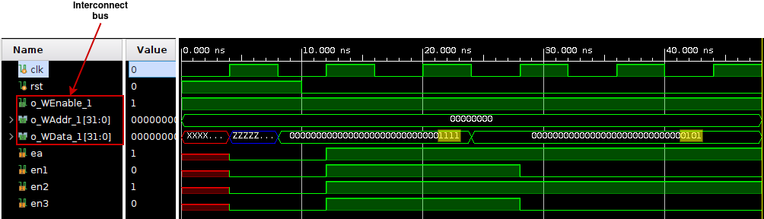
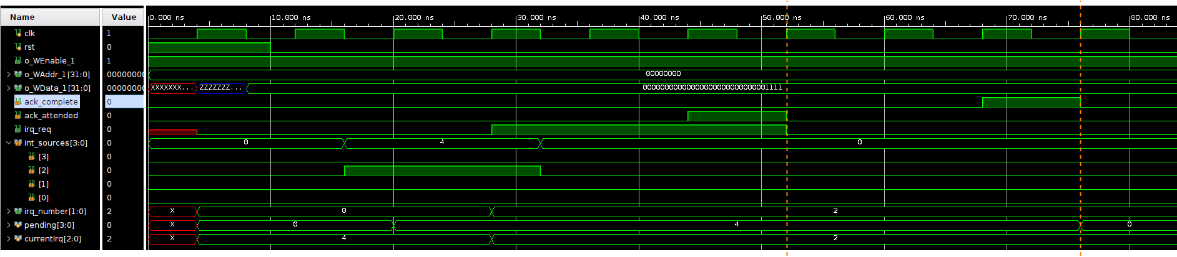
Interrupt Control

Slide 25
Pipeline

Slide 26
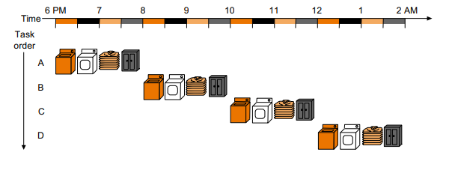
Pipeline Analysis

Slide 27
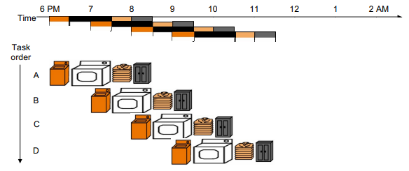
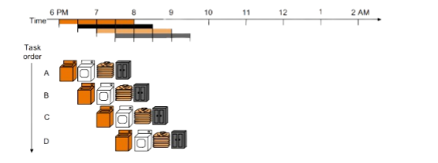
Pipeline Analysis

Slide 28
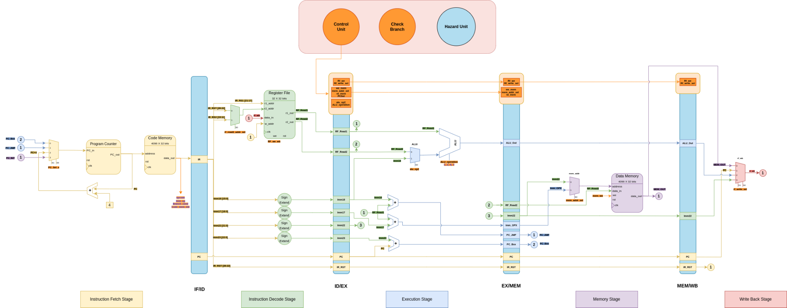
Pipeline Design

Slide 29
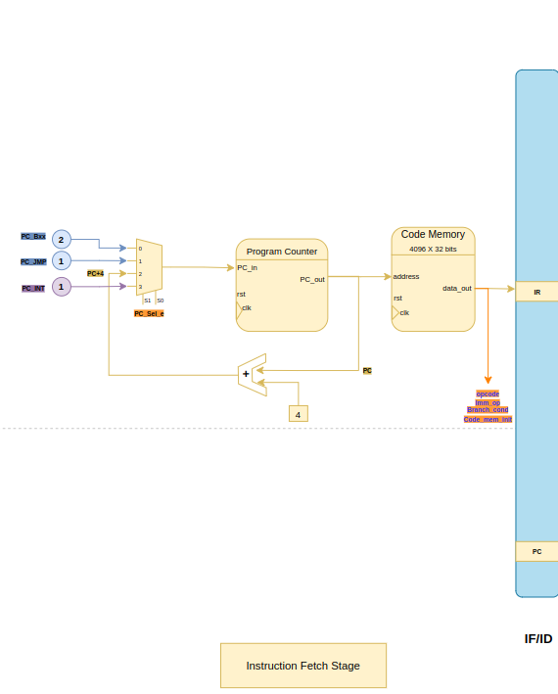
Fetch stage
Update PC & IR value

Slide 30
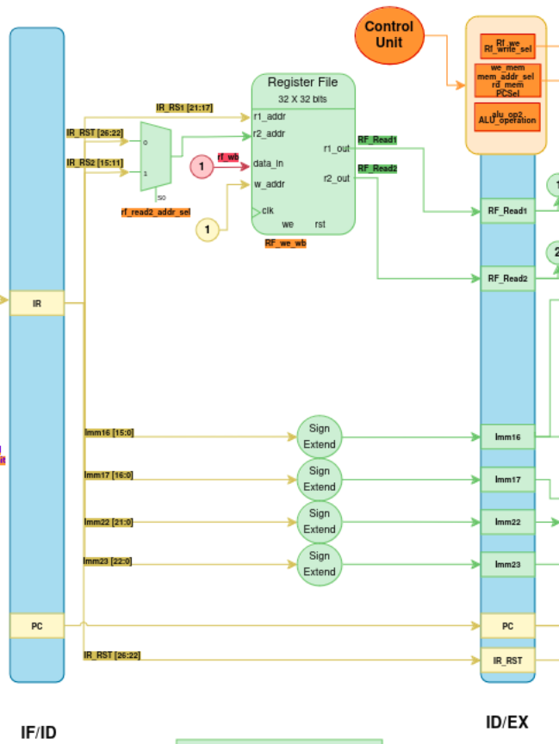
Decode stage
Decode the instruction
Read the register file values
Bypass to the necessary signal to the execute stage
Access the control unit for the control signals needed

Slide 31
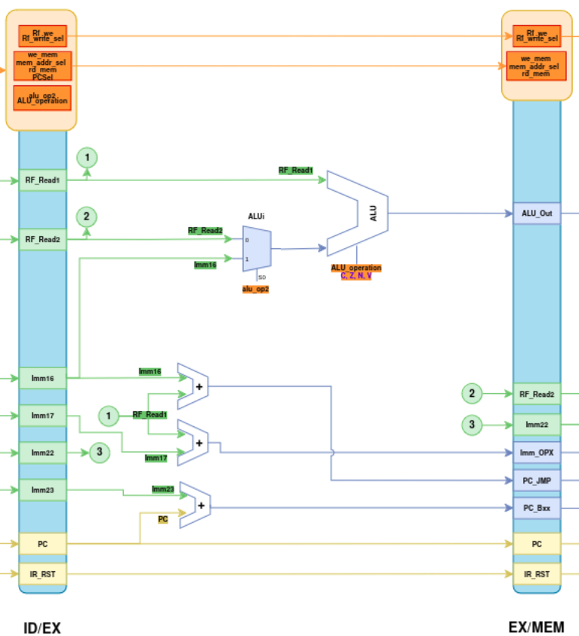
Execute stage
Calculate all values needed
and bypass the necessary signals to the memory stage

Slide 32

Memory stage
Performs all interaction with the data memory and all other peripherals

Slide 33

Write Back stage
Write the data into the register file with all needed signals
The “Data_out” signal does not pass through the pipeline register between memory and writing to the register file to compensate for the delay of 1 cycle of data when read from the peripherals

Slide 34

Control module
This module will have the control unit, hazard unit and the check branch
Control unit will receive the opcodes and send the necessary signals for the operations
Hazard unit will be responsible for controlling the multiplexers associated with hazards, and controlling the stall and flush signals
Check branch will be responsible for checking whether or not the condition is checked

Slide 35

Hazard Unit Analysis
Structural Hazards

Slide 36
Hazard Unit Analysis
Data Hazards
WAW (Write After Write)
Occurs when an instruction attempts to update an operand before it's modified by other, the writing occurs in an incorrect sequence.
WAW hazards mostly occur in pipelined microarchitectures that write in more than one stage to the register file
WAR (Write After Read)
This situation arises when an instruction attempts to update a destination before it's accessed by other instruction causing to mistakenly retrieve the new value
Occurs either when there are some instructions that write results early in the instruction pipeline and other instructions that read a source late in the pipeline
Since VeSPA Pipeline only writes to the register file in the last stage and if all writes occur in the program order, then.
Both hazards are already solved !

Slide 37
Hazard Unit Analysis
Data Hazards
RAW
Occurs when an instruction tries to access a source before it has been written to it, therefore it mistakenly retrieves the old value
Possible Solutions:
Insert NOPs at compile time
Rearrange code at compile time
Scoreboarding (Validation bits in the register file)
Stall the processor at run time
Data forward at run time

Slide 38

Hazard Unit Analysis
ScoreBoarding
Detect if an instruction in the decode will later on write to the regFile and clear the bit of that register
Then Set the bit when the writing is completed
Stall if the bit is 0 when reading a register until it is set again
This would stall the pipeline not only for RAW but also for WAW and WAR hazards

Slide 39
Hazard Unit Analysis
Data Hazards Solutions
Inserting NOPs or re-order instructions at compile time for them to become less dependent
reduces the cost of hardware
overloads the compiler
if the pipeline changes then there would be more need to re-design the backend of compiler
Having a dedicated unit (Hazard Unit) to detect the hazard and stall

Slide 40

Hazard Unit Analysis
Control Hazard
Solutions:
Static Prediction
Dynamic Prediction
The selected solution to
mitigate control hazards was
static prediction (Assume Branch
not taken)

Slide 41

Hazard Unit Design
Structural Hazard
Resolves conflicts between memory-related operations

Slide 42

Hazard Unit Design
Control Hazards
Assume Branch-not-taken (Static Prediction)

Slide 43
Thank you for your attention !

